Slide 1

AI-Powered Skill Matrix
Where the AI lives, how it is protected and how it is checked
Live app: aiskillmatrix.up.railway.app

Slide 2




How the AI is organized
All model code lives in backend/app/ai/
The rest of the app calls small interfaces in that folder. It never imports OpenAI, LangChain or Chroma directly.
No hardcoded secrets
Keys come from environment variables or the platform's secret store. For local work, .env is git-ignored.
The AI integration page in the sidebar shows which components are configured. It never shows secret values.

Slide 3
With and without an AI key
Capability | With OPENAI_API_KEY | Without
Project skills | LLM extraction | Keyword match on the taxonomy
Standardization | Exact, fuzzy, semantic, then a model pick | Exact, fuzzy, then flagged for review
Staffing | Complementary team, reranked locally | Same, with lexical-only embeddings
Learning path | LLM-written plan, Jev-checked courses | Template plan, same checked courses
PDF extraction | LLM reads free text | Tables and "Name:" style only
Every response says which mode produced it (llm, heuristic or template), and the UI shows it.

Slide 4




Find your way around
Workforce
Planning
Project planner · Learning paths
Dashboard
Upload data
Skill matrix
Employees
Standardization
Agents
Run an agent · Approvals
System
AI integration · Users & audit log (admin)
Sign in with the account an administrator created for you. Log out is at the bottom of the sidebar.

Slide 5
Load your data
1
Open Upload data and drop in a file (.xlsx, .xlsm or .pdf, up to 10 MB)
2
Choose the layout: one row per employee, or one row per employee and skill
3
Check the column mapping and the preview of the first 10 employees
4
Choose what happens if an employee already exists: merge or replace all
5
Optional: Check with agent. Then press Import to load the employees
If the agent proposes better settings, an HR manager approves them under Approvals; then press Refresh preview.

Slide 6
Plan a project
1
Open Project planner and describe the project in plain words: skills, levels, team size
2
Press Extract required skills, then edit the list before you go on
3
Optional: set team size, preferred roles, study plan weeks and study hours per week
4
Press Analyze gaps & find staffing (or Gaps only, or Staffing only)
5
Read Predicted gaps and Suggested staffing, then press Create learning path for a person
Gaps show as Covered, At risk (close to covered) or Nobody yet.

Slide 7


Learning paths and approvals
Learning paths
Approvals
Choose an employee, hours per week and target skills
Press Generate study plan
Copy Markdown or Download .md
Ask The Professor (the Learning Coach) about the plan
Agents only propose; nothing changes until a person decides
HR managers decide skill mappings and upload settings
Project managers and team leaders decide project briefs
Press Approve or Reject

Slide 8
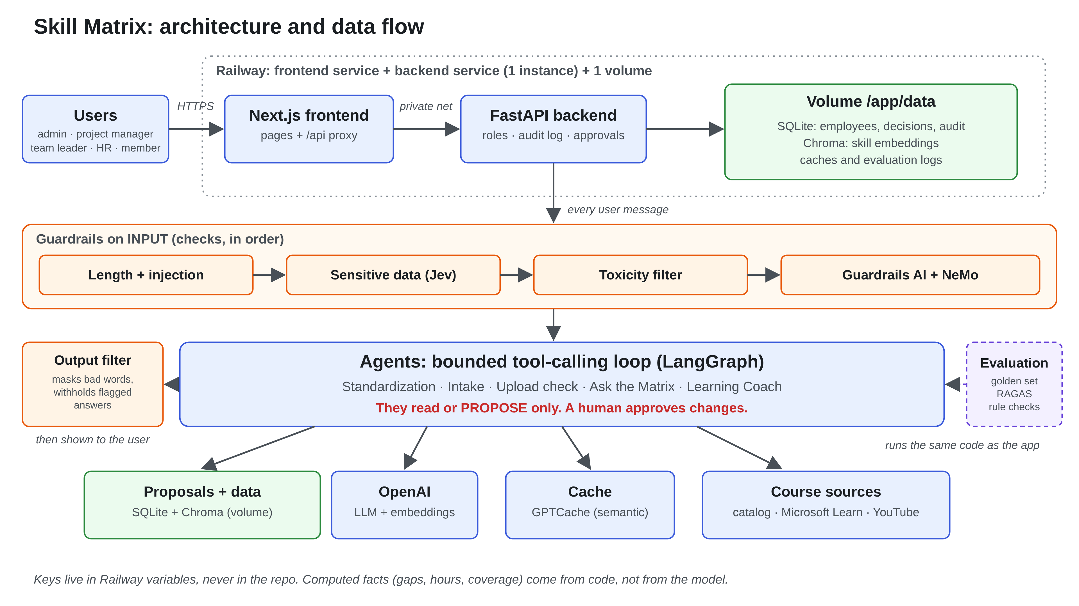
Notes:
Users open the Next.js frontend, which talks to the FastAPI backend on Railway. The backend keeps SQLite, Chroma and caches on a volume. Every message passes the input guardrails, then the agents, which only read or propose. An output filter checks answers before the user sees them.

Slide 9






The main components
LLM
Embeddings
Vector DB
Model, provider and temperature are set in ai/llm.py
text-embedding-3-small, swappable; re-index after a change
Chroma, with each employee as a parent entity
Reranker
Orchestration
Caching
Local FlashRank cross-encoder, no hosted API
LangGraph or sequential, set by ORCHESTRATION
Redis for exact matches, GPTCache for semantic
Also in the code: prompts, tracing (Langfuse, LangSmith) and a fine-tuned model served through OPENAI_BASE_URL.

Slide 10
Agents: read and propose only
Standardization
A bounded tool-calling loop on the configured chat model
Agents only read or propose. A person approves every change
Only exact matches and earlier human decisions apply on their own
Intake
Upload check
Ask the matrix
Learning Coach
Skill levels use a 0 to 4 scale
0 None
1 Learned
2 Applied
3 Experienced
4 Mastered

Slide 11

Jev decisions and learning content
Jev picks one option from a fixed list
Learning content sources
Sensitive-data guardrail
Course relevance, for every course in a plan
Gap-risk bands: Low, Medium, High
Optional model step in standardization
Curated catalog (course_catalog.csv)
Microsoft Learn, no key needed
YouTube, with a daily search cap
Every course must pass Jev's relevance check. Without TYPESAFE_API_KEY, no course links are shown.

Slide 12
Guardrails: input and output
Length
›
Prompt injection
›
Sensitive data (Jev)
›
Toxic language
›
Personal data + NeMo
Output checks
When something goes wrong
Listed words in AI answers are masked (f***)
Answers flagged by moderation alone are withheld
URLs the model invented in plans are removed
Toxic input gets a short, polite request to rephrase
Other violations show as an error
A provider error passes the request only if GUARDRAILS_PROVIDER_FAIL=open

Slide 13
Evaluation results
21 / 21
standardization cases pass
100%
staffing rule checks
1 / 1
privacy guardrail case blocked
Golden set v4, 3 runs, RAGAS 0.4.3, judge gpt-4.1-mini. Answer relevancy has no floor: chat 0.753, learning 0.69, coach 0.66. The set is small and fictional, so use it to catch regressions.

Slide 14
Production on Railway
Frontend
Deployed from a private GitHub repo with Dockerfiles in backend/ and frontend/
One backend instance: jobs, agent runs and rate-limit counters live in memory
Keys are service variables, never in the repo
Health check: GET /api/health
BACKEND_URL is read at build time; keep AUTH_SECRET set
Next.js, proxies /api/*
Backend
FastAPI, one instance
Volume /app/data
SQLite, Chroma, caches

Slide 15



Sign-in and sessions
One session per user
Login lock-out
Signing in on a new device ends the earlier session. Log out ends it on the server too.
5 wrong passwords within 15 minutes lock the username for 15 minutes. Admins can unlock.
Sessions end with a reason
Approvals are decided once
Expiry (12 hours), an admin action or an account change shows a clear message at sign-in.
If two people approve at the same moment, the change is applied once.

Slide 16



Access limits and errors
Who may change data
AI rate limit
Server errors
Taxonomy and requested skills: HR manager and admin.
Re-index and delete all data: admin only.
The server refuses everyone else with 403.
At most 60 AI requests per hour per user.
Over the limit: refused with 429 and a wait time.
Admin is not limited. Agent runs: 30 per hour.
People see a short message and a reference.
Only the admin sees the error text, with key-like text masked.
Search the backend log for the reference.

Slide 17
Interface
A System, Light and Dark switch in the top bar; the choice is remembered in the browser
The sidebar hides on desktop and becomes a drawer on screens under 820px
Neutral look: charcoal and off-white, flat surfaces, no gradients
Every text and background pair passes WCAG AA contrast
Colors with one meaning each
Skill levels 1 to 4
Verified or covered
Pending or at risk
Gap or attention

Slide 18
Status: what is verified
Run for real
Not verified
Open items
OpenAI and Chroma
RAGAS evaluation
Guardrails AI, NeMo, Jev
LangGraph, GPTCache
Learn and YouTube
Redis, Langfuse, LangSmith
Udemy API (sample data)
Unsloth fine-tuning
Full check on Railway
Newer features in a browser
Practice-task sentence is written by the model
Rate-limit counts reset on restart
Skill remapping is open to every staff role
Last updated 10 November 2026

